Slide 1
Kano model developed by Noriaki Kano
Purposes:
Classifies features by impact on user satisfaction
Helps prioritize product development
Connects functionality with emotional response
Three key types:
Basic (must-have)
Performance
Excitement (delighters)

Slide 2
Feature types
Types | Attributes
Basic | Expected features. Missing → dissatisfaction
Performance | Better performance → higher satisfaction
Excitement | Unexpected features → strong positive reaction

Slide 3
Application to AI Candidate Search
Types | Features
Basic | - Search functionality - Stable filters - System stability
Performance | - Ranking accuracy - Speed - Clear match score
Excitement | - AI explanation - Adaptive feedback learning

Slide 4
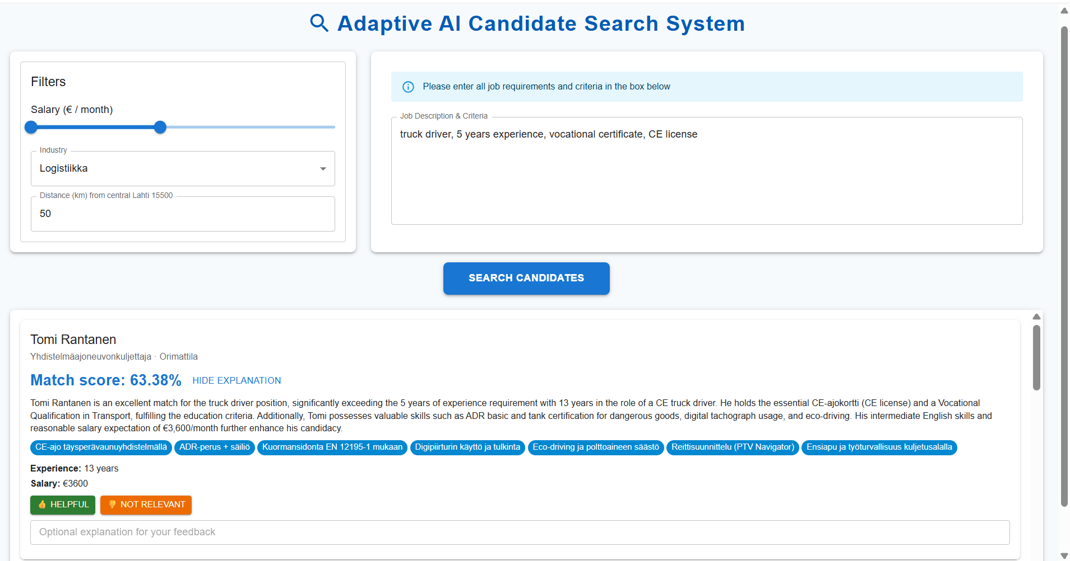
Design impact
Key differentiator:
Explainability + Adaptivity
In AI systems:
Basic features ensure usability
Performance features build trust
Excitement features create innovation perception
Kano influenced UI priorities:
Match score emphasized (performance feature)
Explanation visible (excitement feature)
Filters simple and reliable (basic feature)

Slide 5
Conclusion
Kano helped us:
Prioritize system features
Justify UI design decisions
Identify competitive advantages
Align AI transparency with user satisfaction
In AI-powered recruitment tools: Delighter features build trust and differentiation.

Slide 6
Thank you

